Slide 1
Analyzing Airline Reviews for Sentiment Insights
British Airways
Imane Midoune
23/03/2025

Slide 2
Data was scraped from Skytrax, containing 1,000 customer reviews of British Airways.
- Positive reviews: 623
- Negative reviews: 361
- Neutral reviews: 16
- This means that the majority of reviews are positive.

Slide 3
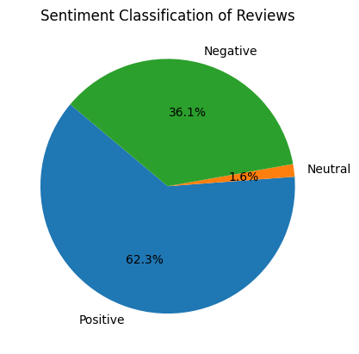
Pie Chart

Slide 4
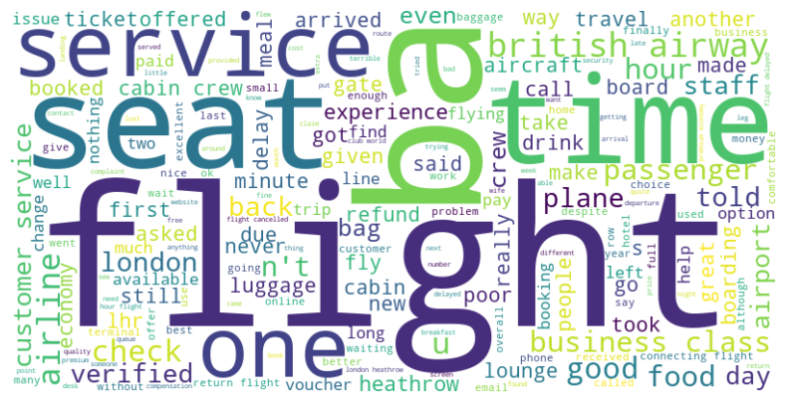
Word Count
- The word count image below shows that the key topics within the reviews include: service, flight, seat, time, and staff.

